Slide 1
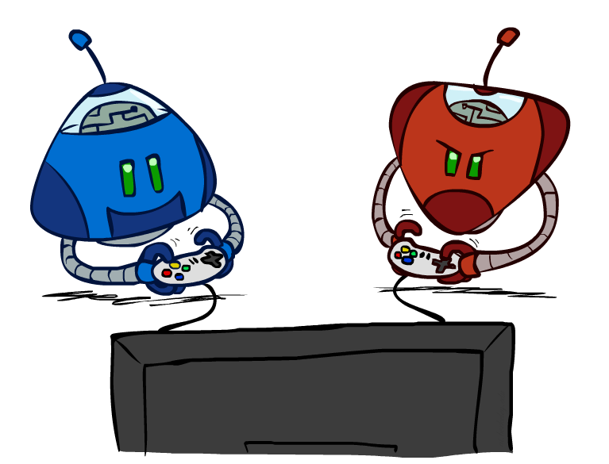
CS 188: Artificial Intelligence
Search with Other Agents
Instructor: Anca Dragan
University of California, Berkeley
[These slides adapted from Dan Klein and Pieter Abbeel]
Notes:
Please retain proper attribution, including the reference to ai.berkeley.edu. Thanks!

Slide 2
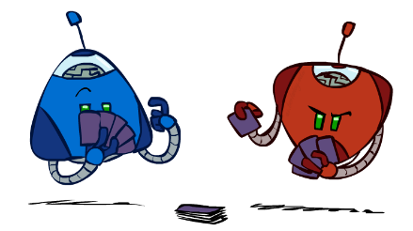

Types of Games
Many different kind of games:
Deterministic or stochastic?
One, two, or more players?
Zero sum or (somewhat) collaborative?
Perfect information (can you see the state)?
Will focus on adversarial, deterministic games with perfect information in this slide show!
Notes:
Not poker – imperfect information, stochastic
Just two players; for today, 0 sum

Slide 3
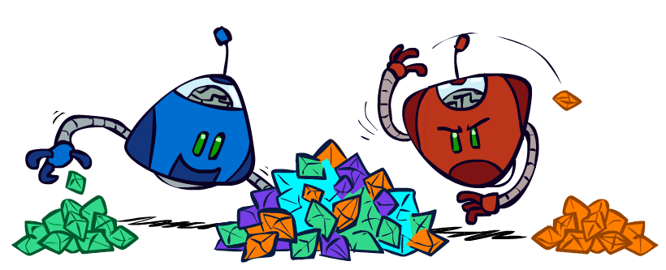
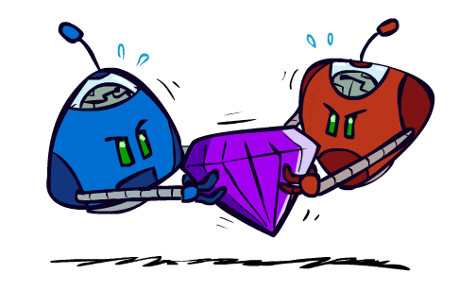
Types of Games Continued
General Games
Agents have independent utilities (values on outcomes)
Cooperation, indifference, adversarial, obeying security rules, and might involve combinations of those behaviors.
Zero-Sum Games
Agents have opposite utilities (values on outcomes)
Lets us think of a single value that one maximizes and the other minimizes
Adversarial, pure competition

Slide 4
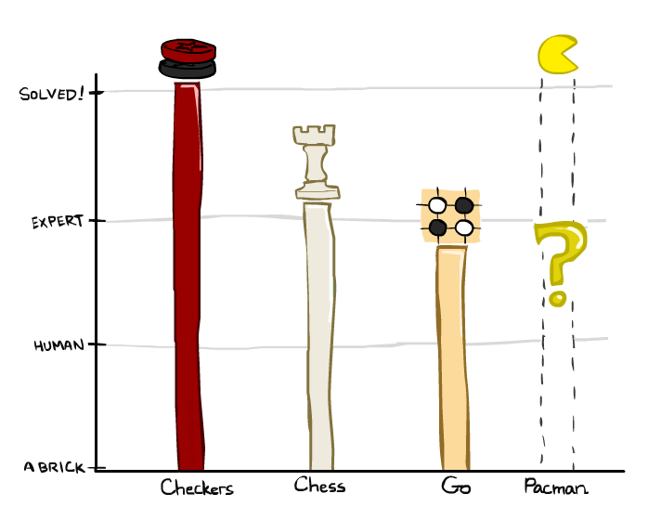
Zero-Sum Game Games ☺
Checkers: 1950: First computer player. 1994: First computer champion: Chinook ended 40-year-reign of human champion Marion Tinsley using complete 8-piece endgame. 2007: Checkers solved!
Chess: 1997: Deep Blue defeats human champion Gary Kasparov in a six-game match. Deep Blue examined 200M positions per second, used very sophisticated evaluation and undisclosed methods for extending some lines of search up to 40 ply. Current programs are even better, if less historic.
Go: Human champions are now starting to be challenged by machines, though the best humans still beat the best machines. In go, b > 300! Classic programs use pattern knowledge bases, but big recent advances use Monte Carlo (randomized) expansion methods.

Slide 5

Zero-Sum Game Games ☺
Checkers: 1950: First computer player. 1994: First computer champion: Chinook ended 40-year-reign of human champion Marion Tinsley using complete 8-piece endgame. 2007: Checkers solved!
Chess: 1997: Deep Blue defeats human champion Gary Kasparov in a six-game match. Deep Blue examined 200M positions per second, used very sophisticated evaluation and undisclosed methods for extending some lines of search up to 40 ply. Current programs are even better, if less historic.
Go :2016: Alpha GO defeats human champion. Uses Monte Carlo Tree Search, learned evaluation function.
Pacman

Slide 6
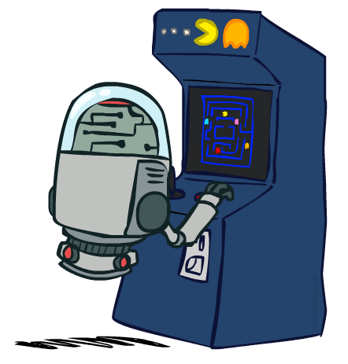
Deterministic Games with Terminal Utilities
Many possible formalizations, one is:
States: S (start at s₀)
Players: P={1...N} (usually take turns)
Actions: A (may depend on player / state)
Transition Function: SxA → S
Terminal Test: S → {t,f}
Terminal Utilities: SxP → R
Solution for a player is a policy: S → A

Slide 7

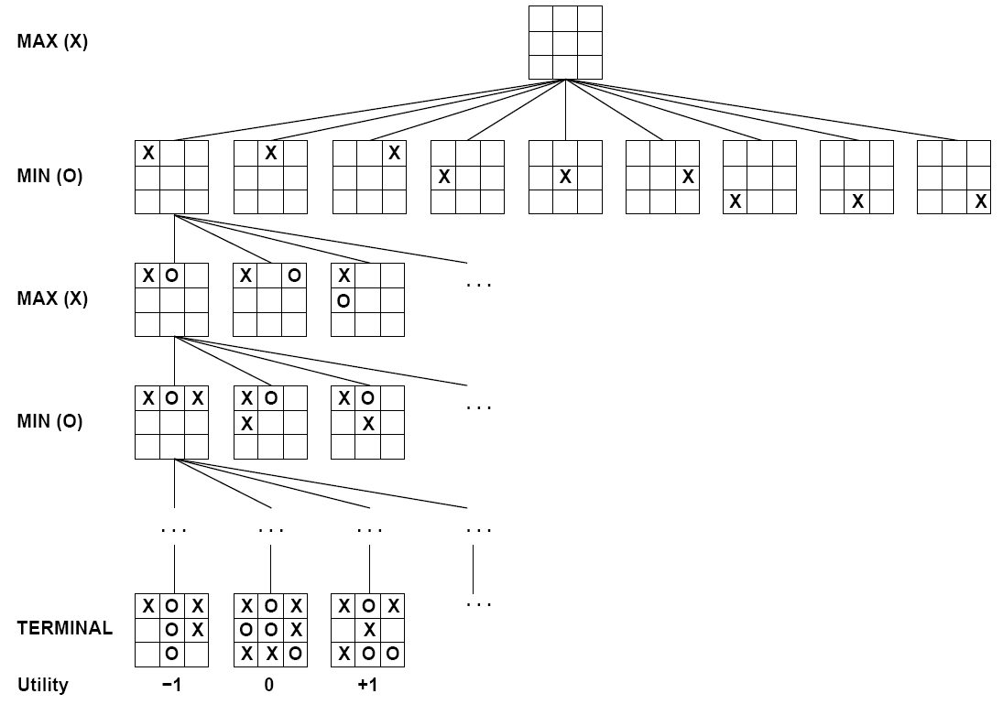

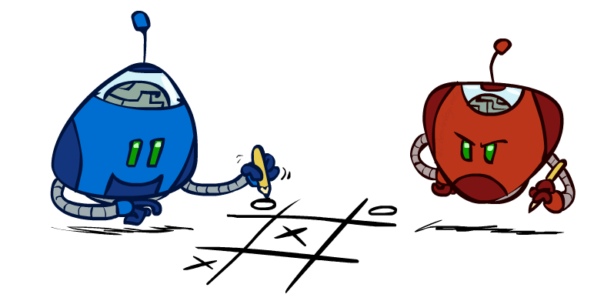
Tic-Tac-Toe Game Tree
Notes:
2nd player is going to force a draw
The value of the root is 0

Slide 8
Adversarial Search (Minimax)
Deterministic, zero-sum games:
Tic-tac-toe, chess, checkers
One player maximizes result
The other minimizes result
Minimax search:
A state-space search tree
Players alternate turns
Compute each node’s minimax value: the best achievable utility against a rational (optimal) adversary
Minimax values: computed recursively
5
max
2
5
min
8
2
5
6
Terminal values: part of the game
Notes:
The algorithm you run propagates things up the tree

Slide 9
Minimax Example
3
3
2
2
3
12
8
2
4
6
14
5
2

Slide 10
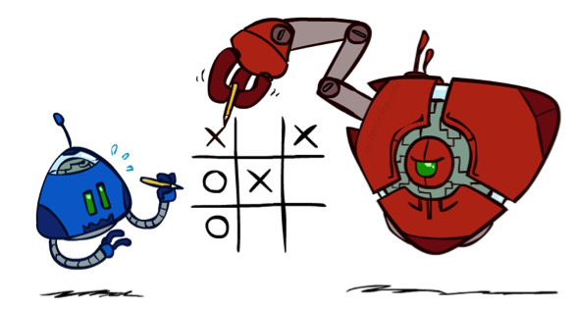
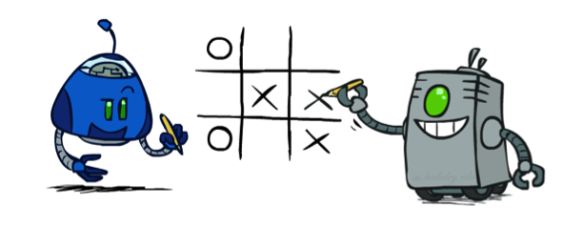
Minimax Properties
max
min
10
10
9
100
Optimal against a perfect player. Otherwise?
[Demo: min vs exp (L6D2, L6D3)]
Notes:
correct against evil mastermind; they won’t let you take the 100
What if we don’t have a perfect player? What if we have this guy? Maybe with this guy you should go for 100.

Slide 11
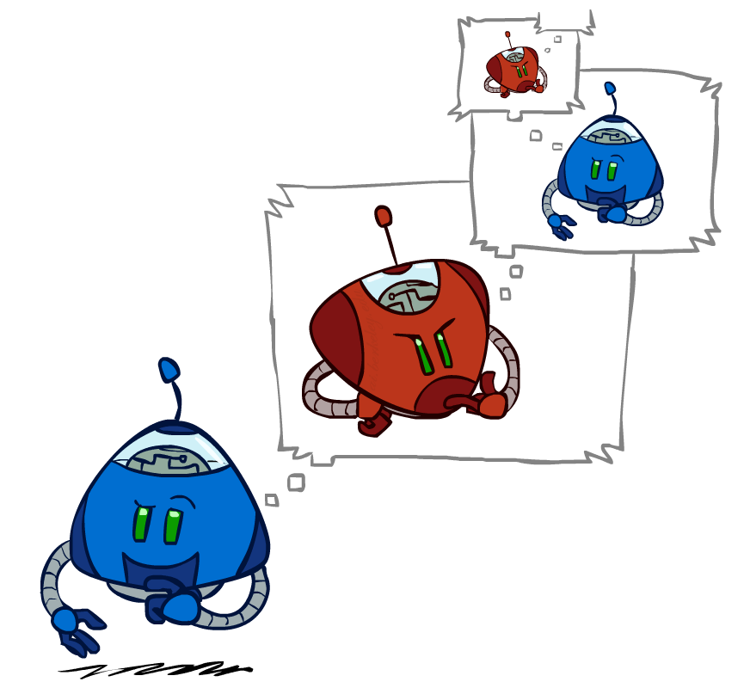
Minimax Efficiency
How efficient is minimax?
Just like (exhaustive) DFS
Time: O(b^{m})
Space: O(bm)
Example: For chess, b ≈ 35, m ≈ 100
Exact solution is completely infeasible
But, do we need to explore the whole tree?
Notes:
If you could brute force your way, chess would be solved. It would probably be a draw.
Don’t play chess, just say eh, it’s a draw.

Slide 12
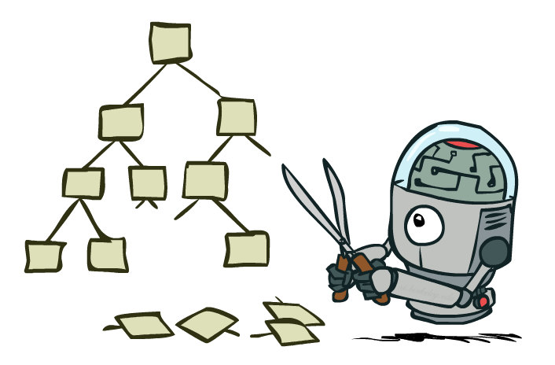
Game Tree Pruning

Slide 13
Minimax Example
3
3
<=2
2
3
12
8
2
14
5
2

Slide 14
Alpha-Beta Pruning
General configuration (MIN version)
We’re computing the MIN-VALUE at some node n
We’re looping over n’s children
n’s estimate of the childrens’ min is dropping
Who cares about n’s value? MAX
Let a be the best value that MAX can get at any choice point along the current path from the root
If n becomes worse than a, MAX will avoid it, so we can stop considering n’s other children (it’s already bad enough that it won’t be played)
MAX version is symmetric
MAX
MIN
a
MAX
MIN
n

Slide 15
Alpha-Beta Pruning Properties
This pruning has no effect on minimax value computed for the root!
Good child ordering improves effectiveness of pruning
With “perfect ordering”:
Time complexity drops to O(b^{m/2})
Doubles solvable depth!
Full search of, e.g. chess, is still hopeless…
This is a simple example of metareasoning (computing about what to compute)
max
min
10
10
0

Slide 16

Resource Limits

Slide 17
Resource Limits
Problem: In realistic games, cannot search to leaves!
Solution: Depth-limited search
Instead, search only to a limited depth in the tree
Replace terminal utilities with an evaluation function for non-terminal positions
Example:
Suppose we have 100 seconds, can explore 10K nodes / sec
So can check 1M nodes per move
α-β reaches about depth 8 – decent chess program
Guarantee of optimal play is gone
More plies makes a BIG difference
Use iterative deepening for an anytime algorithm
max
4
-2
4
min
-1
-2
4
9
?
?
?
?

Slide 18
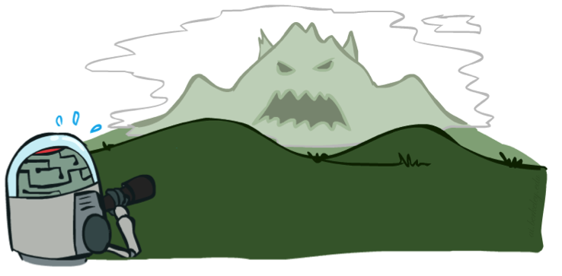

Depth Matters
Evaluation functions are always imperfect
The deeper in the tree the evaluation function is buried, the less the quality of the evaluation function matters
An important example of the tradeoff between complexity of features and complexity of computation
[Demo: depth limited (L6D4, L6D5)]

Slide 19
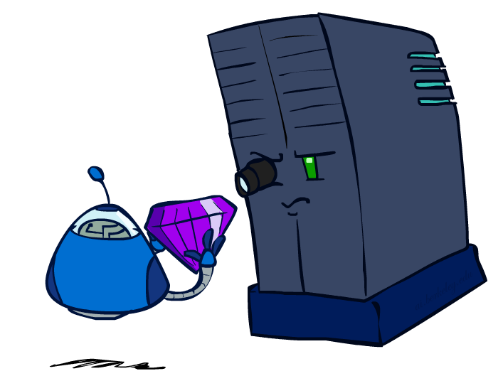
Evaluation Functions

Slide 20
Evaluation Functions
Evaluation functions score non-terminals in depth-limited search
Ideal function: returns the actual minimax value of the position
In practice: typically weighted linear sum of features:
e.g. f₁(s) = (num white queens – num black queens), etc.

Slide 21
Other Kind of Games
Christoph F. Eick
Backgammon: the game playing strategy has to deal with dice rolls which are probabilistic events. Evolutionary Computing and AI approaches have been quite successful to develop world class backgammon agents.
Bridge and other card games: the game strategy has to deal with missing or incomplete information; the hands of the opponents are not known but following probabilistic rules and can often been inferred from game actions taken. There are no world class level Bridge agents at the moment, but Bridge agents are improving…
Poker ?!?, Angry Bird: ?!?

